Slide 1

An Educational Horror Game
By Shihui Li
Student num:190206187
Mail:b9020618@newcastle.ac.uk
Earlier version
Full game
Full Blueprints

Slide 2



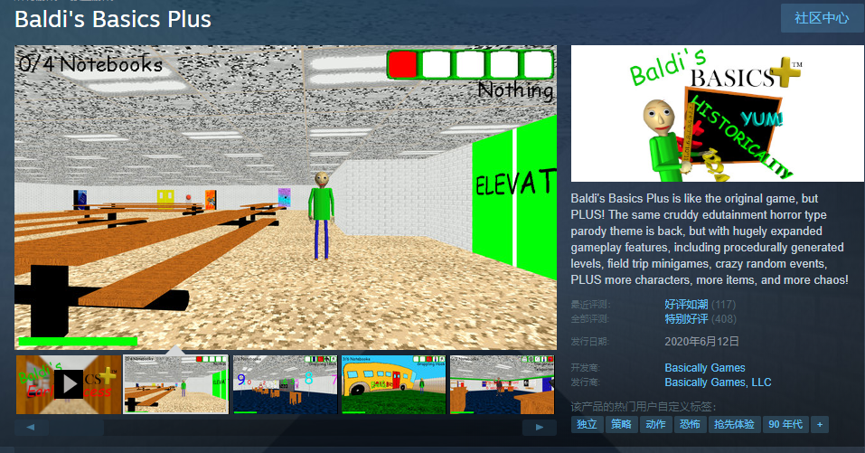
Games often have different themes and types
But some of them may be camouflages
They are all
HORROR GAMES
https://www.youtube.com/watch?v=mbmbuCp_MCw&t=42s
https://www.youtube.com/watch?v=aVWOcEptfO8&t=2s

Slide 3



Water Conservation Game
Saving Water as a
Two Key Elements:
Water Amount
Task Completion

Slide 4
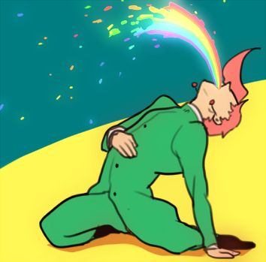
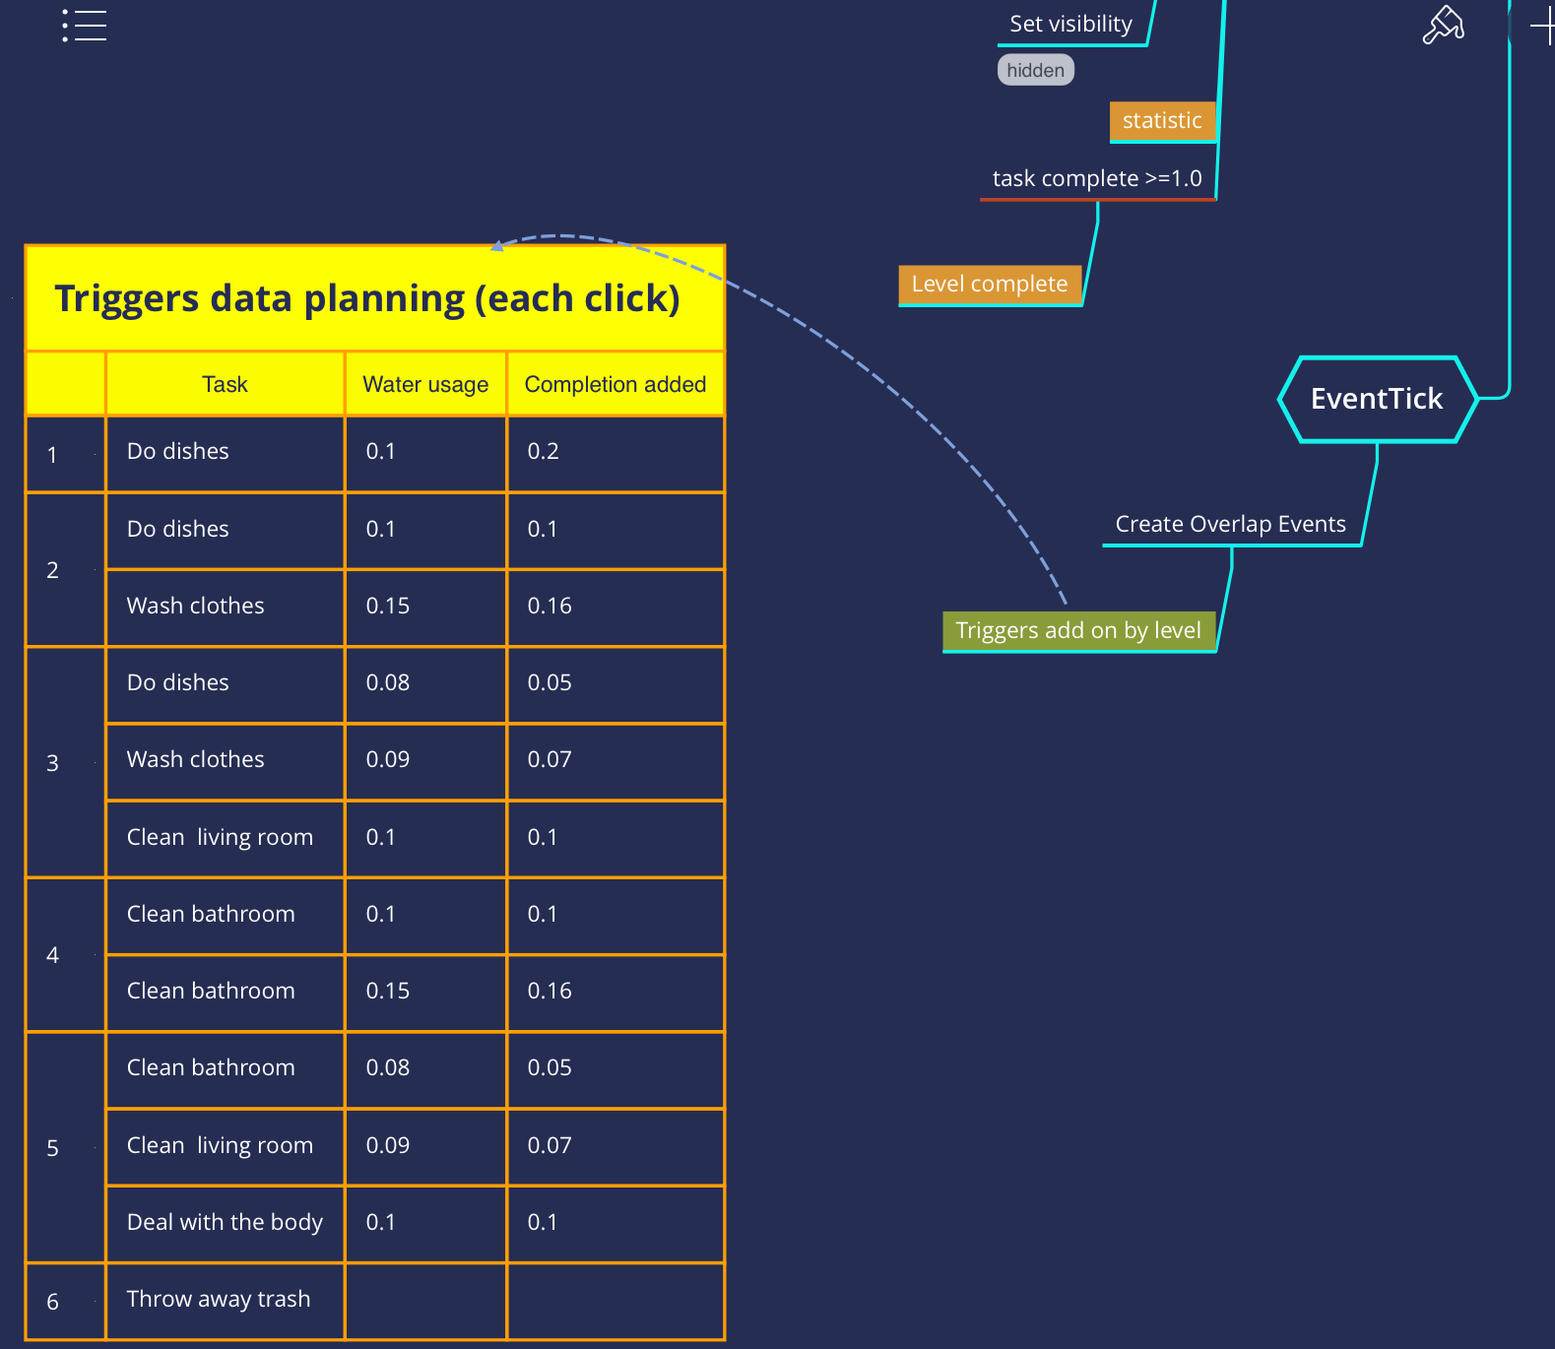


Main Rules
A math problem actually!
Click to do the housework
Accumulate the competition
And try not to waste too much water
(In danger!)

Slide 5


Saving Water as a
The
abnormal
is invading into
normal
Horror Game
It is hard to define normal or abnormal, because both of them are subjective words. When what is described as ‘abnormal’ generally infiltrates and erodes someone’s ‘normal’ life, it might be difficult for him to distinguish. Researchers tried to tell the difference between normal and abnormal, by observing two aspects of human lives: the way of violent evacuation and communication of unbearable states of mind.

Slide 6



The main challenge is how to present the feeling of
P
E
N
E
T
R
A
T
I
O
N
Disguise and Confusion
Seeing isn’t believing
Disguise and Confusion
Something’s getting more and more wired

Slide 7
Disguise and Confusion
At first, it looks like an educational game that teaches people to save water in daily life. But it will show its dark side during the game, shocking players that are not mentally prepared.
The principle of this kind of game design is separating its GOALS and PURPOSES.

Slide 8
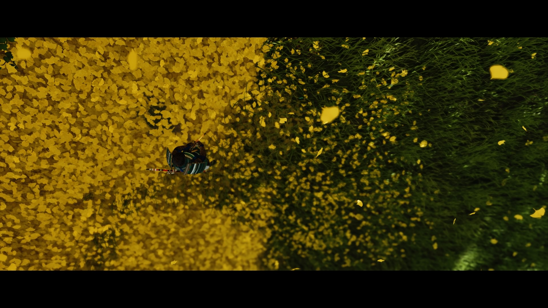




Goals and Purpose
What is a goal
What is a purpose
One of the most distinguishing features of a game is that games are advanced by different goals.
Purposes are what the game tries to achieve.
The goal of Saving Water is to complete the tasks with limited amount of water.
The purpose of Saving Water is to tell a story about murder.

Slide 9

Changing Details
(taking newspaper text as an example)
Level num | Text on the Newspaper
1 | By failing to protect our water we have failed everything Improve water supply in poorer nations to cut plastic use, say experts
2 | New water treatment system put into use today Research about new tech of water purify is under-going
3 | High quality of water will have been provided by the end of this month Woman disappeared in town last night.
4 | Report about water usage in town has been published Missing person still has not been found She deserved that!
5 | My love, do you recall the object which we saw, That fair, sweet, summer morn! At a turn in the path a ■■■■ ■■■■■■■ On a gravel strewn bed,
6 | GO FORTH TOWARDS THE LIGHT
Games which are limited in a specific and unchanged play scene usually make good use of a great deal of details. It can be considered as a technique of expression.
In this game, newspaper, textures, sounds, even the main menu, is changing along with the whole scheme being revealed. Changes of details are to impress the story line and enhance the feeling of penetration.

Slide 10
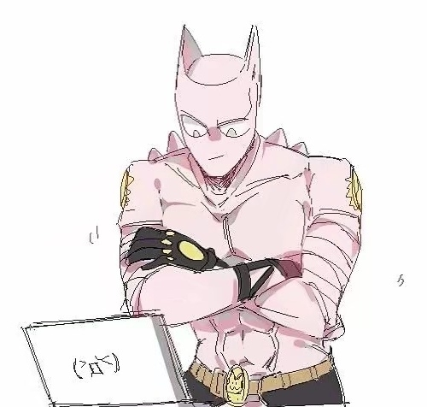
Thank you for watching
Evaluation and Conclusion
This is a game designed to show a simple water conservation process related to everyday activities. But that is more than that. Underneath water conservation, it is actually a horror game which tells a story of murder. Although the game is simple, it is creative and of bold design. Making an anti-traditional game is worthy of trying.

